Slide 1
Services

Slide 2
Objectives
After completing this lesson, you should be able to:
  Configure and manage services in a RAC environment
  Use services with client applications
  Use services with the Database Resource Manager
  Use services with the Scheduler
  Set performance-metric thresholds on services
  Configure services aggregation and tracing
Notes:
Oracle Database 11g: RAC Administration 7 - <number>

Slide 3
Traditional Workload Dispatching
Daytime
HR
DW
CRM
Batch
Payday
Holiday season
HR
DW
CRM
Batch
HR
DW
CRM
Batch
Notes:
Traditional Workload Dispatching
In a standard environment, isolated computing units of different sizes are permanently dedicated to specific applications such as Human Resources, Data Warehouses, Customer Relationship Management, and Retail Batches.
These computing units need to be sized for their peak workload. As the peak workload occurs for some hours only, a considerable amount of resources is idle for a long time.

Slide 4
Grid Workload Dispatching
Daytime
Idle
DW
HR
Batch
CRM
Payday
Holiday season
Idle
Idle
DW
Batch
Batch
HR
DW
CRM
HR
CRM
Notes:
Grid Workload Dispatching
With grid computing, a global pool of computing units can be provided, and the computing units can be temporarily assigned to specific applications. Computing units can then be dynamically exchanged between applications. During business hours, more units can be used for CRM applications, and after business hours, some of them can be transferred to Retail Batches.
Grid computing minimizes unused resources. This means that overall a grid-enabled environment needs less computing power than an environment that is not grid enabled.
In the example, 25 percent of the computing resource units are idle. This unused extra capacity is there so that service levels can still be met in case of failure of components, such as nodes or instances, and also to deal with unexpected workloads. This is much better than the industry average of 70 to 90 percent idle rates when each machine is sized for its individual maximum.

Slide 5
Data Warehouse: Example
ETL
DB
EUT
ETL
DB
EUT
11:00 p.m.
3:00 a.m.
ETL
DB
EUT
9:00 a.m.
Notes:
Data Warehouse: Example
Previously, building a business intelligence system required the integration of multiple server products. The result was that such systems were unnecessarily complex. The integration of multiple servers was costly. After the system was implemented, there was an ongoing administration cost in maintaining different servers and keeping the data synchronized across all servers.
At 11:00 p.m.: ETL server is busy using ETL outside the database; moderate load on database; no load on end user server.
At 3:00 a.m.: No load on ETL server; moderate load on database (canned reporting, aggregation, and potential data mart maintenance); no load on end user server.
At 9:00 a.m.: No load on ETL server; moderate load on database; end user server is busy using analysis outside the database.
In addition, each system has to be sized according to the expected workload peaks.

Slide 6
RAC and Data Warehouse: An Optimal Solution
ETL
DB
EUT
  Maximum total workload used for system sizing:
    Size(Workload max total) < Σ Size(workload max components)
  The entire workload is evenly spread across all nodes at any point in time.

Slide 7
Next Step
What works for a single data warehouse …
ETL
DB
EUT
ETL
DB
EUT
… works in a larger environment as well.

Slide 8
What Is a Service?
  Is a means of grouping sessions that are doing the same kind of work
  Provides a single-system image instead of a multiple-instances image
  Is a part of the regular administration tasks that provide dynamic service-to-instance allocation
  Is the base for High Availability of connections
  Provides a new performance-tuning dimension
Notes:
What Is a Service?
The concept of a service was first introduced in Oracle8i as a means for the listener to perform connection load balancing between nodes and instances of a cluster. However, the concept, definition, and implementation of services have been dramatically expanded. Services are a feature for workload management that organizes the universe of work execution within the database to make that work more manageable, measurable, tunable, and recoverable. A service is a grouping of related tasks within the database with common functionality, quality expectations, and priority relative to other services. A service provides a single-system image for managing competing applications running within a single instance and across multiple instances and databases.
Using standard interfaces, such as the DBCA, Enterprise Manager, and SRVCTL, services can be configured, administered, enabled, disabled, and measured as a single entity.
Services provide availability. Following outages, a service is recovered quickly and automatically at surviving instances.
Services provide a new dimension to performance tuning. With services, workloads are visible and measurable. Tuning by “service and SQL” replaces tuning by “session and SQL” in the majority of systems where sessions are anonymous and shared.
Services are dynamic in that the number of instances a service runs on can be augmented when load increases, and reduced when load declines. This dynamic resource allocation enables a cost-effective solution for meeting demands as they occur.

Slide 9
High Availability of Services in RAC
  Services are available continuously with load shared across one or more instances.
  Additional instances are made available in response to failures.
  Preferred instances:
    Set the initial cardinality for the service
    Are the first to start the service
  Available instances are used in response to preferred-instance failures.
Notes:
High Availability of Services in RAC
With RAC, the focus of High Availability (HA) is on protecting the logically defined application services. This focus is more flexible than focusing on high availability of instances.
Services must be location independent and the RAC HA framework is used to implement this. Services are made available continuously with load shared across one or more instances in the cluster. Any instance can offer services in response to run-time demands, failures, and planned maintenance.
To implement the workload balancing and continuous availability features of services, Oracle Clusterware stores the HA configuration for each service in the Oracle Cluster Registry (OCR). The HA configuration defines a set of preferred and available instances that support the service.
A preferred instance set defines the number of instances (cardinality) that support the corresponding service. It also identifies every instance in the cluster that the service will run on when the system first starts up.
An available instance does not initially support a service. However, it begins accepting connections for the service when a preferred instance cannot support the service. If a preferred instance fails, then the service is transparently restored to an available instance defined for the service.
Note: An available instance can become a preferred instance and vice versa.

Slide 10
Possible Service Configuration with RAC
Active/spare
RAC01
RAC02
RAC03
AP
AP
GL
GL
Active/symmetric
Active/asymmetric
RAC01
RAC02
RAC03
RAC01
RAC02
RAC03
AP
AP
AP
AP
AP
AP
GL
GL
GL
GL
GL
GL
Notes:
Possible Service Configuration with RAC
Active/spare: With this service configuration, the simplest redundancy known as primary/secondary, or 1+1 redundancy is extended to the general case of N+M redundancy, where N is the number of primary RAC instances providing service, and M is the number of spare RAC instances available to provide the service. An example of this solution is a three-node configuration in which one instance provides the AP service, the second instance provides the GL service, and the third instance provides service failover capability for both services. The spare node can still be available for other applications during normal operation.
Active/symmetric: With this service configuration, the same set of services is active on every instance. An example of this is illustrated in the slide, with both AP and GL services being offered on all three instances. Each instance provides service load-sharing and service failover capabilities for the other.
Active/asymmetric: With this service configuration, services with lower capacity needs can be defined with single cardinality and configured as having all other instances capable of providing the service in the event of failure. The slide shows the AP service running on only one instance, and the GL service running on two instances. The first instance supports the AP services and offers failover for the GL service. Likewise, the second and third instances support the GL service and offer failover for AP. If either the first or third instance dies, then GL and AP are still offered through the second instance.

Slide 11
Service Attributes
  Global unique name
  Network name
  Load Balancing Advisory goal*
  Distributed transactions flag*
  Advance queuing notification characteristics for OCI and ODP.NET clients*
  Failover characteristics*
  Connection load-balancing algorithm*
  Threshold
  Priority
  High-availability configuration*
Notes:
Service Attributes
When you create new services for your database, you should define each service’s workload management characteristics. The characteristics of a service include:
A unique global name to identify the service
A Net Service name that a client uses to connect to the service
A service goal that determines whether work requests are made to the service based on best service quality (service response time), or best throughput (how much work is completed in a unit of time), as determined by the Load Balancing Advisory
An indicator that determines whether the service will be used for distributed transactions
An indicator that determines whether RAC HA events are sent to OCI and ODP.NET clients that have registered to receive them through Advanced Queuing
The characteristics of session failovers when using transparent application failover
The method for load balancing (which you can define) of connections for each service:
SHORT: Use Load Balancing Advisory
LONG: Using session count by service
Services metric thresholds (which you can define) for response time and CPU consumption
Services to consumer groups (which you can map) instead of usernames
How the service is distributed across instances when the system first starts
Note: Attributes highlighted with an * in the slide cannot be defined for single-instance environments.

Slide 12
Service Types
  Application services:
    Limit of 100 services per database
  Internal services:
    SYS$BACKGROUND
    SYS$USERS
    Cannot be deleted or changed
Notes:
Service Types
Oracle Database 10g supports two broad types of services: application services and internal services. Application services are mainly functional maps to workloads. Sessions doing work for a common business function are grouped together. For Oracle E-Business suite, AP, AR, GL, MFG, WIP, BOM, and so on create a functional division of work within the database and can thus be categorized as services.
In addition to application services, the RDBMS also supports two internal services. SYS$BACKGROUND is used by the background processes only. SYS$USERS is the default service for user sessions that are not associated with any application service. Both internal services support all the workload management features and neither one can be stopped or disabled.
There is a limitation of 100 application services per database that you can create. Also, a service name is restricted to 64 characters.
Note: Shadow services are also included in the application service category. For more information about shadow services, see the lesson titled “High Availability of Connections.” In addition, a service is also created for each Advanced Queue created. However, these types of services are not managed by Oracle Clusterware. Using service names to access a queue provides location transparency for the queue within a RAC database.

Slide 13
Service Goodness
  Value that reflects the ability of a node and instance to deliver work for a service
  Appropriate metrics used to compute goodness depending on the service goal:
    Service time
    Service throughput
  Automatically computed at each instance by MMNL
Notes:
Service Goodness
Service goodness is a measure of the attractiveness of an instance to provide resources for a service. MMNL calculates moving average for service time and service throughput. These values are exposed in GV$SERVICEMETRIC and GV$SERVICEMETRIC_HISTORY.
Note: MMNL is the Manageability MoNitor Light process.

Slide 14
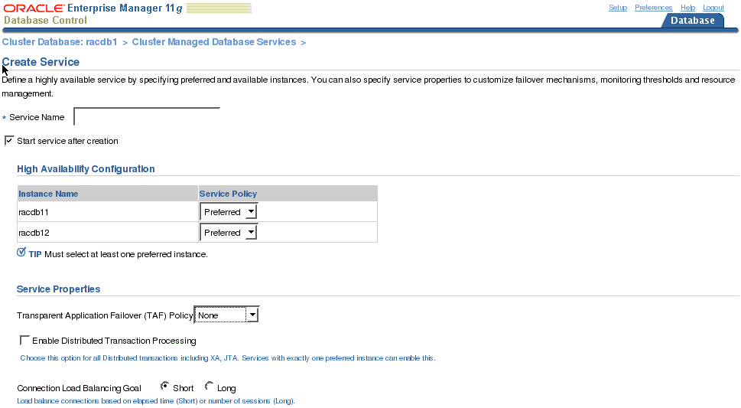
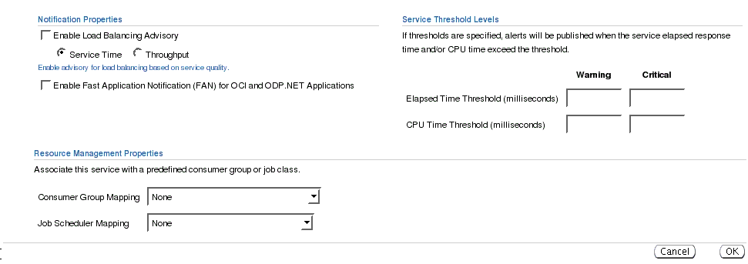
Create Services with Enterprise Manager
Notes:
Create Services with Enterprise Manager
On your Cluster Database home page, click the Availability tab. On the Availability tabbed page, click Cluster Managed Database Services. On the Cluster Managed Database Services page, click Create Service.
Use the Create Service page to configure a new service in which you do the following:
Select the desired service policy for each instance configured for the cluster database.
Select the desired service properties. Refer to the “Service Attributes” topic in this lesson for more information about the properties you can specify on this page. The Transparent Application Failover (TAF) policy attribute on this page does not configure server-side TAF.
Note: Although Enterprise Manager configures Oracle Clusterware resources for your newly created services, it does not generate the corresponding entries in your tnsnames.ora files. You have to manually edit them. For that, you can use the srvctl config database command with the –t option, which displays the TNS entries that you should use for the services created with srvctl. Here is an example:
$ srvctl config database -d xwkE –t
Example client-side TNS entry for service Standard:
Standard = (DESCRIPTION=(ADDRESS=(PROTOCOL=TCP)(HOST=db_vip) (PORT=dedicated_port))(CONNECT_DATA=(SERVICE_NAME=Standard))) …

Slide 15
Create Services with SRVCTL
$ srvctl add service –d PROD –s GL -r RAC02 -a RAC01
$ srvctl add service –d PROD –s AP –r RAC01 -a RAC02
RAC02
AP
GL
AP
GL
RAC01
Notes:
Create Services with SRVCTL
The example in the slide shows a two-node cluster with an instance named RAC01 on one node and an instance called RAC02 on the other. The cluster database name is PROD.
Two services—AP and GL—are created and stored in the cluster repository to be managed by Oracle Clusterware. The AP service is defined with a preferred instance of RAC01 and an available instance of RAC02.
If RAC01 dies, the AP service member on RAC01 is restored automatically on RAC02. A similar scenario holds true for the GL service.
Note that it is possible to assign more than one instance with both the -r and -a options. However, -r is mandatory whereas -a is optional.
Services enable you to move beyond the simple two-node primary/secondary configuration of RAC Guard in Oracle9i.
With Oracle Database 11g, multiple primary nodes can support a service with RAC. Possible configurations for service placement are active/spare, active/symmetric, and active/asymmetric. Once a service is created, you can use the srvctl add service command with the –u –r or –u –a option to add a preferred or available instance to a service.
Note: You can also set up a service for Transparent Application Failover by using the –P option of SRVCTL. Possible values are NONE, BASIC, and PRECONNECT.

Slide 16

Preferred and Available Instances
$ srvctl add service –d PROD –s ERP \
–r RAC01,RAC02 -a RAC03,RAC04
1
2
RAC01
RAC02
RAC03
RAC04
RAC01
RAC02
RAC03
RAC04
ERP
ERP
ERP
ERP
ERP
ERP
ERP
ERP
4
3
RAC01
RAC02
RAC03
RAC04
RAC01
RAC02
RAC03
RAC04
ERP
ERP
ERP
ERP
ERP
ERP
ERP
ERP
Notes:
Preferred and Available Instances
In this example, it is assumed that you have a four-node cluster.
You define a service called ERP. The preferred instances for ERP are RAC01 and RAC02. The available instances for ERP are RAC03 and RAC04.
1. Initially, ERP connections are directed only to RAC01 and RAC02.
2. RAC02 is failing and goes down.
3. Oracle Clusterware detects the failure of RAC02, and because the cardinality of ERP is 2, Oracle Clusterware restores the service on one of the available instances, in this case RAC03.
4. ERP connection requests are now directed to RAC01 and RAC03, which are the instances that currently offer the service. Although Oracle Clusterware is able to restart RAC02, the ERP service does not fall back to RAC02. RAC02 and RAC04 are now the instances that are accessible if subsequent failures occur.
Note: If you want to fall back to RAC02, you can use SRVCTL to relocate the service. This operation can be done manually by the DBA, or by coding the SRVCTL relocation command using a callback mechanism to automate the fallback. However, relocating a service is a disruptive operation.

Slide 17
Modify Services with the DBMS_SERVICE Package
Modify a service in RAC with the following:
  SRVCTL
  Enterprise Manager
  DBMS_SERVICE.MODIFY_SERVICE
exec DBMS_SERVICE.MODIFY_SERVICE (
'SELF-SERVICE', 'SELF-SERVICE.us.oracle.com',
goal => DBMS_SERVICE.GOAL_SERVICE_TIME,
clb_goal => DBMS_SERVICE.CLB_GOAL_SHORT);
Notes:
Modify Services with the DBMS_SERVICE Package
The DBMS_SERVICE package supports the management of services in the database for the purposes of workload measurement, management, prioritization, and distributed transaction management. This package allows the creation, deletion, starting, and stopping of services in both RAC and a single instance. Additionally, it provides the ability to disconnect all sessions that connect to the instance with a service name when RAC removes that service name from the instance. Although the preferred method to create a service in a RAC environment is to use SRVCTL or Enterprise Manager, you can use the DBMS_SERVICE.CREATE_SERVICE procedure to create a service in a single-instance environment. This is because the DBMS_SERVICE package is not integrated with Oracle Clusterware to define preferred and available instances for the service.
However, you can use the DBMS_SERVICE.MODIFY_SERVICE procedure to modify some of the service’s attributes in a RAC environment that cannot be modified using Enterprise Manager (for example, the FAILOVER_RETRIES parameter).
The example in the slide shows you how to use DBMS_SERVICE.MODIFY_SERVICE to set the Load Balancing Advisory goal for SELF-SERVICE. Refer to the “Service Attributes” topic in this lesson for more information about these attributes.
Note: For more information about the DBMS_SERVICE package, see the PL/SQL Packages and Types Reference.

Slide 18
Everything Switches to Services
  Data dictionary maintains services.
  The AWR measures the performance of services.
  The Database Resource Manager uses services in place of users for priorities.
  Job scheduler, Parallel Query (PQ), and Streams queues run under services.
  RAC keeps services available within a site.
  Data Guard Broker with RAC keeps primary services available across sites.
Notes:
Everything Switches to Services
Several database features support services. A session is tracked by the service with which it connects. In addition, performance-related statistics and wait events are also tracked by services.
The Automatic Workload Repository (AWR) manages the performance of services. It records the service performance, including SQL execution times, wait classes, and resources consumed by service. The AWR alerts the DBA when service response time thresholds are exceeded. Specific dynamic performance views report current service status with one hour of history.
In Oracle Database 10g, the Database Resource Manager is capable of managing services for prioritizing application workloads within an instance. In addition, jobs can now run under a service, as opposed to a specific instance. Parallel slave processes inherit the service of their coordinator.
The RAC HA framework keeps services available within a site. Data Guard Broker, in conjunction with RAC, migrates the primary service across Data Guard sites for disaster tolerance.

Slide 19
Use Services with Client Applications
ERP=(DESCRIPTION=
(LOAD_BALANCE=on)
(ADDRESS=(PROTOCOL=TCP)(HOST=node-1vip)(PORT=1521))
(ADDRESS=(PROTOCOL=TCP)(HOST=node-2vip)(PORT=1521))
(ADDRESS=(PROTOCOL=TCP)(HOST=node-3vip)(PORT=1521))
(ADDRESS=(PROTOCOL=TCP)(HOST=node-4vip)(PORT=1521))
(CONNECT_DATA=(SERVICE_NAME=ERP)))
url="jdbc:oracle:oci:@ERP"
url="jdbc:oracle:thin:@(DESCRIPTION=
(LOAD_BALANCE=on)
(ADDRESS=(PROTOCOL=TCP)(HOST=node-1vip)(PORT=1521))
(ADDRESS=(PROTOCOL=TCP)(HOST=node-2vip)(PORT=1521))
(ADDRESS=(PROTOCOL=TCP)(HOST=node-3vip)(PORT=1521))
(ADDRESS=(PROTOCOL=TCP)(HOST=node-4vip)(PORT=1521))
(CONNECT_DATA=(SERVICE_NAME=ERP)))"
Notes:
Use Services with Client Applications
Applications and mid-tier connection pools select a service by using the TNS connection descriptor.
The selected service must match the service that has been created using SRVCTL or the DBCA.
The address lists in each example in the slide use virtual IP addresses. Using the virtual IP addresses for client communication ensures that connections and SQL statements issued against a node that is down do not result in a TCP/IP timeout.
The first example in the slide shows the TNS connect descriptor that can be used to access the ERP service.
The second example shows the thick JDBC connection description using the previously defined TNS connect descriptor.
The third example shows the thin JDBC connection description using the same TNS connect descriptor.
Note: The LOAD_BALANCE=ON clause is used by Oracle Net to randomize its progress through the protocol addresses of the connect descriptor. This feature is called client connection load balancing.

Slide 20
Use Services with the Resource Manager
  Consumer groups are automatically assigned to sessions based on session services.
  Work is prioritized by service inside one instance.
AP
Instance resources
Connections
AP
75%
BATCH
BATCH
25%
Notes:
Use Services with the Resource Manager
The Database Resource Manager (also called Resource Manager) enables you to identify work by using services. It manages the relative priority of services within an instance by binding services directly to consumer groups. When a client connects by using a service, the consumer group is assigned transparently at connect time. This enables the Resource Manager to manage the work requests by service in the order of their importance.
For example, you define the AP and BATCH services to run on the same instance, and assign AP to a high-priority consumer group and BATCH to a low-priority consumer group. Sessions that connect to the database with the AP service specified in their TNS connect descriptor get priority over those that connect to the BATCH service.
This offers benefits in managing workloads because priority is given to business functions rather than the sessions that support those business functions.
Note: The Database Resource Manager applies only when the system resources are under heavy utilization. If there are free CPU cycles, BATCH (in the slide example) could get more than 25 percent.

Slide 21
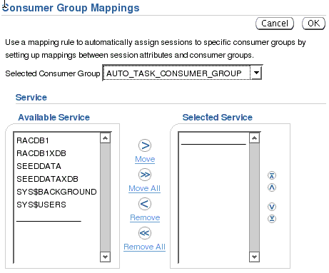
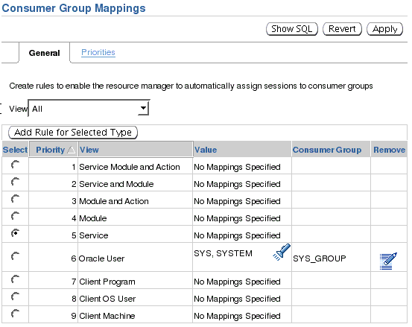
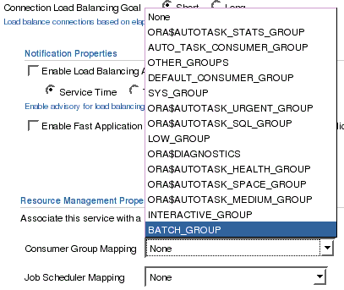
Services and Resource Manager with EM
Notes:
Services and Resource Manager with EM
Enterprise Manager (EM) presents a GUI through the Consumer Group Mapping page to automatically map sessions to consumer groups. You can access this page by clicking the Consumer Group Mappings link on the Server page.
Using the General tabbed page of the Consumer Group Mapping page, you can set up a mapping of sessions connecting with a service name to consumer groups (as shown in the right part of the slide).
With the ability to map sessions to consumer groups by service, module, and action, you have greater flexibility when it comes to managing the performance of different application workloads.
Using the Priorities tabbed page of the Consumer Group Mapping page, you can change priorities for the mappings that you set up on the General tabbed page. The mapping options correspond to columns in V$SESSION. When multiple mapping columns have values, the priorities you set determine the precedence for assigning sessions to consumer groups.
Note: You can also map a service to a consumer group directly on the Create Service page (as shown in the left part of the slide).

Slide 22
Services and the Resource Manager: Example
exec DBMS_RESOURCE_MANAGER.CREATE_PENDING_AREA;
exec DBMS_RESOURCE_MANAGER.CREATE_CONSUMER_GROUP(
CONSUMER_GROUP => 'HIGH_PRIORITY',
COMMENT => 'High priority consumer group');
exec DBMS_RESOURCE_MANAGER.SET_CONSUMER_GROUP_MAPPING(
ATTRIBUTE => DBMS_RESOURCE_MANAGER.SERVICE_NAME,
VALUE => 'AP',
CONSUMER_GROUP => 'HIGH_PRIORITY');
exec DBMS_RESOURCE_MANAGER.SUBMIT_PENDING_AREA;
exec - DBMS_RESOURCE_MANAGER_PRIVS.GRANT_SWITCH_CONSUMER_GROUP(-
GRANTEE_NAME => 'PUBLIC',
CONSUMER_GROUP => 'HIGH_PRIORITY',
GRANT_OPTION => FALSE);
Notes:
Services and the Resource Manager: Example
Assume that your site has two consumer groups called HIGH_PRIORITY and LOW_PRIORITY. These consumer groups map to a resource plan for the database that reflects either the intended ratios or the intended resource consumption.
Before mapping services to consumer groups, you must first create the consumer groups and the resource plan for these consumer groups. The resource plan can be priority based or ratio based. The PL/SQL calls shown in the slide are used to create the HIGH_PRIORITY consumer group, and map the AP service to the HIGH_PRIORITY consumer group. You can use similar calls to create the LOW_PRIORITY consumer groups and map the BATCH service to the LOW_PRIORITY consumer group.
The last PL/SQL call in the example in the slide is executed because sessions are automatically assigned only to consumer groups for which they have been granted switch privileges. A similar call should be executed for the LOW_PRIORITY consumer group.
Note: For more information about the Database Resource Manager, refer to the Oracle Database Administrator’s Guide and PL/SQL Packages and Types Reference.

Slide 23
Use Services with the Scheduler
  Services are associated with Scheduler classes.
  Scheduler jobs have service affinity:
    High Availability
    Load balancing
HOT_BATCH_SERV
HOT_BATCH_SERV
LOW_BATCH_SERV
Job coordinator
Job coordinator
Job coordinator
Job slaves
Job slaves
Job slaves
Database
Job table
Job1
HOT_BATCH_CLASS
HOT_BATCH_SERV
Job2
HOT_BATCH_CLASS
HOT_BATCH_SERV
Job3
LOW_BATCH_CLASS
LOW_BATCH_SERV
Notes:
Use Services with the Scheduler
Just as in other environments, the Scheduler in a RAC environment uses one job table for each database and one job coordinator for each instance. The job coordinators communicate with each other to keep information current.
The Scheduler can use the services and the benefits they offer in a RAC environment. The service that a specific job class uses is defined when the job class is created. During execution, jobs are assigned to job classes and job classes run within services. Using services with job classes ensures that the work of the Scheduler is identified for workload management and performance tuning.
For example, jobs inherit server-generated alerts and performance thresholds for the service they run under.
For High Availability, the Scheduler offers service affinity instead of instance affinity. Jobs are not scheduled to run on any specific instance. They are scheduled to run under a service. So, if an instance dies, the job can still run on any other instance in the cluster that offers the service.
Note: By specifying the service where you want the jobs to run, the job coordinators balance the load on your system for better performance.

Slide 24
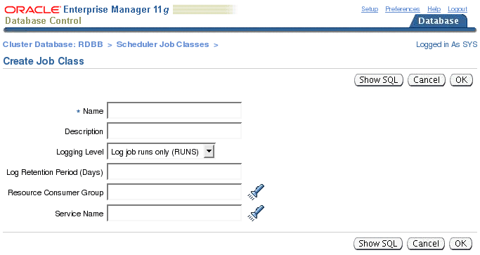
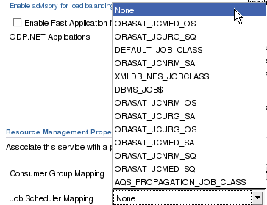
Services and the Scheduler with EM
Notes:
Services and the Scheduler with EM
To configure a job to run under a specific service, click the Job Classes link in the Database Scheduler section of the Server page. This opens the Scheduler Job Classes page. On the Scheduler Job Classes page, you can see services assigned to job classes.
When you click the Create button on the Scheduler Job Classes page, the Create Job Class page is displayed. On this page, you can enter details of a new job class, including which service it must run under.
Note: Similarly, you can map a service to a job class on the Create Service page as shown at the bottom of the slide.

Slide 25
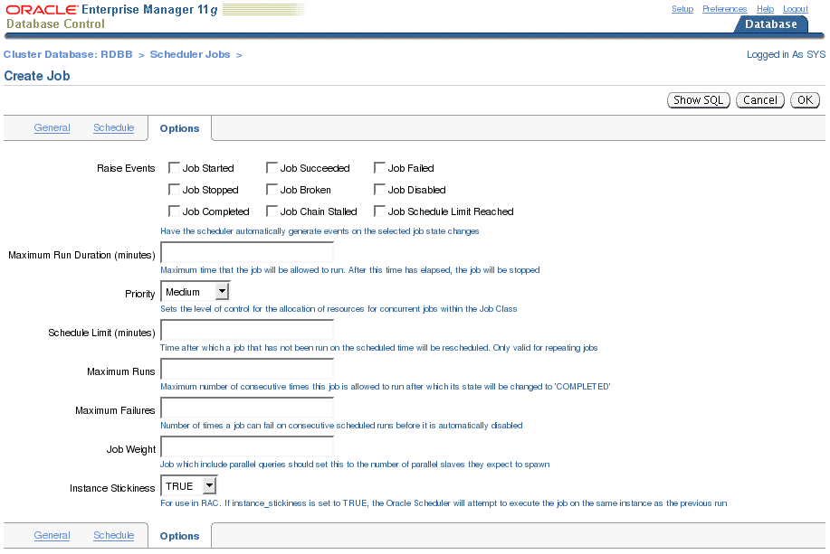
Services and the Scheduler with EM
Notes:
Services and the Scheduler with EM (continued)
After your job class is set up with the service that you want it to run under, you can create the job.
To create the job, click the Jobs link on the Server page. The Scheduler Jobs page appears, on which you can click the Create button to create a new job. When you click the Create button, the Create Job page is displayed. This page has different tabs: General, Schedule, and Options. Use the General tabbed page to assign your job to a job class.
Use the Options page (displayed in the slide) to set the Instance Stickiness attribute for your job. Basically, this attribute causes the job to be load balanced across the instances for which the service of the job is running. The job can run only on one instance. If the Instance Stickiness value is set to TRUE, which is the default value, the Scheduler runs the job on the instance where the service is offered with the lightest load. If Instance Stickiness is set to FALSE, then the job is run on the first available instance where the service is offered.
Note: It is possible to set job attributes, such as INSTANCE_STICKINESS, by using the SET_ATTRIBUTE procedure of the DBMS_SCHEDULER PL/SQL package.

Slide 26
Services and the Scheduler: Example
DBMS_SCHEDULER.CREATE_JOB_CLASS(
JOB_CLASS_NAME => 'HOT_BATCH_CLASS',
RESOURCE_CONSUMER_GROUP => NULL ,
SERVICE => 'HOT_BATCH_SERV' ,
LOGGING_LEVEL => DBMS_SCHEDULER.LOGGING_RUNS,
LOG_HISTORY => 30, COMMENTS => 'P1 batch');
DBMS_SCHEDULER.CREATE_JOB(
JOB_NAME => 'my_report_job',
JOB_TYPE => 'stored_procedure',
JOB_ACTION => 'my_name.my_proc();',
NUMBER_OF_ARGUMENTS => 4, START_DATE => SYSDATE+1,
REPEAT_INTERVAL => 5, END_DATE => SYSDATE+30,
JOB_CLASS => 'HOT_BATCH_CLASS', ENABLED => TRUE,
AUTO_DROP => false, COMMENTS => 'daily status');
Notes:
Services and the Scheduler: Example
In this PL/SQL example, you define a batch queue, HOT_BATCH_CLASS, managed by the Scheduler. You associate the HOT_BATCH_SERV service to the HOT_BATCH_CLASS queue. It is assumed that you had already defined the HOT_BATCH_SERV service.
After the class is defined, you can define your job. In this example, the MY_REPORT_JOB job executes in the HOT_BATCH_CLASS job class at instances offering the HOT_BATCH_SERV service.
In this example, you do not assign a resource consumer group to the HOT_BATCH_CLASS job class. However, it is possible to assign a consumer group to a class. Regarding services, this allows you to combine Scheduler jobs and service prioritization by using the Database Resource Manager.
Note: For more information about the Scheduler, refer to the Oracle Database Administrator’s Guide and PL/SQL Packages and Types Reference.

Slide 27

Use Services with Parallel Operations
  Slaves inherit the service from the coordinator.
  Slaves only execute on instances running the service.
ERP
ERP
ERP
Node 1
ERP
Node 2
ERP
ERP
Node 3
Node 4
ERP
ERP
ERP
Execution
coordinator
Shared disks
Parallel
Execution
server
Notes:
Use Services with Parallel Operations
For parallel query and parallel DML operations, the parallel query slaves inherit the service from the query coordinator for the duration of the operation. ERP is the name of the service used by the example shown in the slide.
By default—and starting with Oracle RAC 11gR1—services restrict the set of instances that are used by a parallel query. Connecting via a service and then issuing a parallel query can use only those instances that are part of the service that was specified during the connection. This is implemented by automatically modifying the INSTANCE_GROUPS parameter to reflect SERVICE_NAMES and by using the service name used to connect to select the instance group to use for parallel operations (unless you specified PARALLEL_INSTANCE_GROUP to a different value).
To override this behavior, set a value for the INSTANCE_GROUPS and PARALLEL_INSTANCE_GROUP initialization parameters. In that case, a slave appears to belong under the service even on an instance that does not support the service, if that slave is being used by a query coordinator that was started on an instance that does support that service. At the end of the execution, the slaves revert to the default database service. Note, however, that INSTANCE_GROUPS is a deprecated initialization parameter and is retained only for backward compatibility purposes.

Slide 28
Use Services with Metric Thresholds
  You can define service-level thresholds:
    ELAPSED_TIME_PER_CALL
    CPU_TIME_PER_CALL
  Server-generated alerts are triggered on threshold violations.
  You can react on generated alerts:
    Change priority.
    Relocate services.
    Add instances for services.
SELECT service_name, elapsedpercall, cpupercall
FROM V$SERVICEMETRIC;
Notes:
Use Services with Metric Thresholds
Service-level thresholds permit the comparison of actual service levels against the accepted minimum required level. This provides accountability with respect to delivery or failure to deliver an agreed service level.
You can explicitly specify two metric thresholds for each service on a particular instance:
The response time for calls, ELAPSED_TIME_PER_CALL: The response time goal indicates a desire for the elapsed time to be, at most, a certain value. The response time represents the wall clock time. It is a fundamental measure that reflects all delays and faults that block the call from running on behalf of the user.
CPU time for calls: CPU_TIME_PER_CALL
The AWR monitors the service time and publishes AWR alerts when the performance exceeds the thresholds. You can then respond to these alerts by changing the priority of a job; stopping overloaded processes; or relocating, expanding, shrinking, starting, or stopping a service. Using automated tasks, you can automate the reaction. This enables you to maintain service quality despite changes in demand.
Note: The SELECT statement shown in the slide gives you the accumulated instance statistics for elapsed time and for CPU-used metrics for each service for the most recent 60-second interval. For the last-hour history, look at V$SERVICEMETRIC_HISTORY.

Slide 29
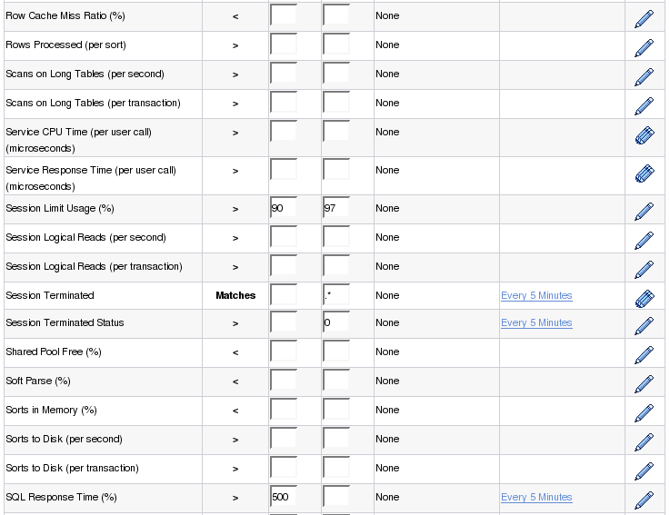
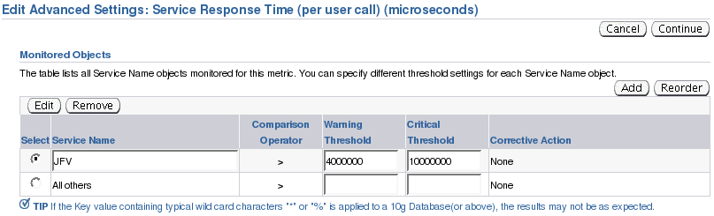
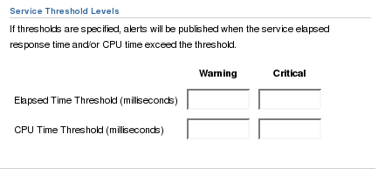
Change Service Thresholds by Using EM
Notes:
Change Service Thresholds by Using EM
You can set threshold values for your services from the Database Instance Metric and Policy Settings page. You can access this page from the Database Instance home page by clicking the Metric and Policy Settings link in the Related Links section.
Using the Metric and Policy Settings page, you can set the Service CPU Time (per user call) and Service Response Time (per user call) metrics for your services. If you modify the critical and warning values on this page, the thresholds apply to all services of the instance. If you want different thresholds for different services, click the corresponding icon on the last column of the table as shown in the slide. This takes you to the corresponding Edit Advanced Settings page. There, you can click Add to add rows to the Monitored Objects table. Each row represents a particular service in this case.
Note: You can directly set service thresholds from the Create Service page as shown at the bottom of the slide.

Slide 30
Services and Metric Thresholds: Example
exec DBMS_SERVER_ALERT.SET_THRESHOLD(-
METRICS_ID => dbms_server_alert.elapsed_time_per_call,
WARNING_OPERATOR => dbms_server_alert.operator_ge,
WARNING_VALUE => '500000',
CRITICAL_OPERATOR => dbms_server_alert.operator_ge,
CRITICAL_VALUE => '750000',
OBSERVATION_PERIOD => 15,
CONSECUTIVE_OCCURRENCES => 3,
INSTANCE_NAME => 'I0n',
OBJECT_TYPE => dbms_server_alert.object_type_service,
OBJECT_NAME => 'ERP');
Thresholds must be set on each instance supporting the service.
Notes:
Services and Metric Thresholds: Example
In this example, thresholds are added for the ERP service for the ELAPSED_TIME_PER_CALL metric. This metric measures the elapsed time for each user call for the corresponding service. The time must be expressed in microseconds.
A warning alert is raised by the server whenever the average elapsed time per call for the ERP service over a 15-minute period exceeds 0.5 seconds three consecutive times.
A critical alert is raised by the server whenever the average elapsed time per call for the ERP service over a 15-minute period exceeds 0.75 seconds three consecutive times.
Note: The thresholds must be created for each RAC instance that potentially supports the service.

Slide 31
Service Aggregation and Tracing
  Statistics are always aggregated by service to measure workloads for performance tuning.
  Statistics can be aggregated at finer levels:
    MODULE
    ACTION
    Combination of SERVICE_NAME, MODULE, ACTION
  Tracing can be done at various levels:
    SERVICE_NAMES
    MODULE
    ACTION
    Combination of SERVICE_NAME, MODULE, ACTION
  This is useful for tuning systems that use shared sessions.
Notes:
Service Aggregation and Tracing
By default, important statistics and wait events are collected for the work attributed to every service. An application can further qualify a service by MODULE and ACTION names to identify the important transactions within the service. This enables you to locate exactly the poorly performing transactions for categorized workloads. This is especially important when monitoring performance in systems by using connection pools or transaction processing monitors. For these systems, the sessions are shared, which makes accountability difficult.
SERVICE_NAME, MODULE, and ACTION are actual columns in V$SESSION. SERVICE_NAME is set automatically at login time for the user. MODULE and ACTION names are set by the application by using the DBMS_APPLICATION_INFO PL/SQL package or special OCI calls. MODULE should be set to a user-recognizable name for the program that is currently executing. Likewise, ACTION should be set to a specific action or task that a user is performing within a module (for example, entering a new customer).
Another aspect of this workload aggregation is tracing by service. The traditional method of tracing each session produces trace files with SQL commands that can span workloads. This results in a hit-or-miss approach to diagnose problematic SQL. With the criteria that you provide (SERVICE_NAME, MODULE, or ACTION), specific trace information is captured in a set of trace files and combined into a single output trace file. This enables you to produce trace files that contain SQL that is relevant to a specific workload being done.

Slide 32
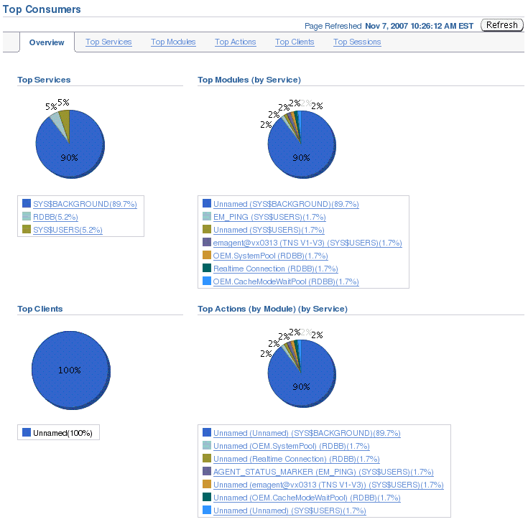
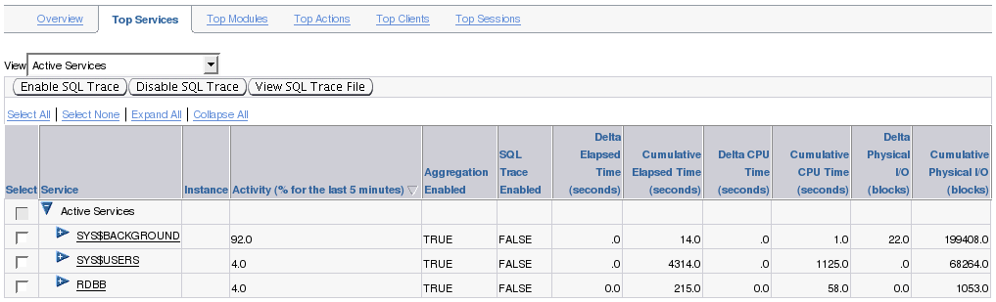
Top Services Performance Page
Notes:
Top Services Performance Page
From the Performance page, you can access the Top Consumers page by clicking the Top Consumers link.
The Top Consumers page has several tabs for displaying your database as a single-system image. The Overview tabbed page contains four pie charts: Top Clients, Top Services, Top Modules, and Top Actions. Each chart provides a different perspective regarding the top resource consumers in your database.
The Top Services tabbed page displays performance-related information for the services that are defined in your database. Using this page, you can enable or disable tracing at the service level, as well as view the resulting SQL trace file.

Slide 33
Service Aggregation Configuration
  Automatic service aggregation level of statistics
  DBMS_MONITOR used for finer granularity of service aggregations:
    SERV_MOD_ACT_STAT_ENABLE
    SERV_MOD_ACT_STAT_DISABLE
  Possible additional aggregation levels:
    SERVICE_NAME/MODULE
    SERVICE_NAME/MODULE/ACTION
  Tracing services, modules, and actions:
    SERV_MOD_ACT_TRACE_ENABLE
    SERV_MOD_ACT_TRACE_DISABLE
  Database settings persist across instance restarts.
Notes:
Service Aggregation Configuration
On each instance, important statistics and wait events are automatically aggregated and collected by service. You do not have to do anything to set this up, except connect with different connect strings using the services you want to connect to. However, to achieve a finer level of granularity of statistics collection for services, you must use the SERV_MOD_ACT_STAT_ENABLE procedure in the DBMS_MONITOR package. This procedure enables statistics gathering for additional hierarchical combinations of SERVICE_NAME/MODULE and SERVICE_NAME/MODULE/ACTION. The SERV_MOD_ACT_STAT_DISABLE procedure stops the statistics gathering that was turned on.
The enabling and disabling of statistics aggregation within the service applies to every instance accessing the database. Furthermore, these settings are persistent across instance restarts.
The SERV_MOD_ACT_TRACE_ENABLE procedure enables tracing for services with three hierarchical possibilities: SERVICE_NAME, SERVICE_NAME/MODULE, and SERVICE_NAME/MODULE/ACTION. The default is to trace for all instances that access the database. A parameter is provided that restricts tracing to specified instances where poor performance is known to exist. This procedure also gives you the option of capturing relevant waits and bind variable values in the generated trace files. SERV_MOD_ACT_TRACE_DISABLE disables the tracing at all enabled instances for a given combination of service, module, and action. Like the statistics gathering mentioned previously, service tracing persists across instance restarts.

Slide 34
Service Aggregation: Example
  Collect statistics on service and module:
  Collect statistics on service, module, and action:
  Trace all sessions of an entire service:
  Trace on service, module, and action:
exec DBMS_MONITOR.SERV_MOD_ACT_STAT_ENABLE(-
'AP', 'PAYMENTS');
exec DBMS_MONITOR.SERV_MOD_ACT_STAT_ENABLE(-
'AP', 'PAYMENTS', 'QUERY_DELINQUENT');
exec DBMS_MONITOR.SERV_MOD_ACT_TRACE_ENABLE('AP');
exec DBMS_MONITOR.SERV_MOD_ACT_TRACE_ENABLE(-
'AP', 'PAYMENTS', 'QUERY_DELINQUENT');
Notes:
Service Aggregation: Example
The first piece of sample code begins collecting statistics for the PAYMENTS module within the AP service. The second example collects statistics only for the QUERY_DELINQUENT program that runs in the PAYMENTS module under the AP service. This enables statistics collection on specific tasks that run in the database.
In the third code box, all sessions that log in under the AP service are traced. A trace file is created for each session that uses the service, regardless of the module and action. To be precise, you can trace only specific tasks within a service. This is illustrated in the last example, where all sessions of the AP service that execute the QUERY_DELINQUENT action within the PAYMENTS module are traced.
Tracing by service, module, and action enables you to focus your tuning efforts on specific SQL, rather than sifting through trace files with SQL from different programs. Only the SQL statements that define this task are recorded in the trace file. This complements collecting statistics by service, module, and action because relevant wait events for an action can be identified.
Note: For more information about the DBMS_MONITOR package, refer to the PL/SQL Packages and Types Reference.

Slide 35
trcsess Utility
Client
Client
Client
Clients
CRM
ERP
CRM
CRM
ERP
CRM
Dedicated
server
Dedicated
server
Dedicated
server
Shared
server
Shared
server
Shared
server
Trace
file
Trace
file
Trace
file
Trace
file
Trace
file
Trace
file
TRCSESS
TRCSESS
Trace file
for CRM service
Trace file
for one client
TKPROF
Report
file
Notes:
trcsess Utility
The trcsess utility consolidates trace output from selected trace files on the basis of several criteria: session ID, client ID, service name, action name, and module name. After trcsess merges the trace information into a single output file, the output file can be processed by tkprof.
When using the DBMS_MONITOR.SERV_MOD_ACT_TRACE_ENABLE procedure, tracing information is present in multiple trace files and you must use the trcsess tool to collect it into a single file.
The trcsess utility is useful for consolidating the tracing of a particular session or service for performance or debugging purposes.
Tracing a specific session is usually not a problem in the dedicated server model because a single dedicated process serves a session during its lifetime. All the trace information for the session can be seen from the trace file belonging to the dedicated server serving it. However, tracing a service might become a complex task even in the dedicated server model.
Moreover, in a shared-server configuration, a user session is serviced by different processes from time to time. The trace pertaining to the user session is scattered across different trace files belonging to different processes. This makes it difficult to get a complete picture of the life cycle of a session.

Slide 36
Service Performance Views
  Service, module, and action information in:
    V$SESSION
    V$ACTIVE_SESSION_HISTORY
  Service performance in:
    V$SERVICE_STATS
    V$SERVICE_EVENT
    V$SERVICE_WAIT_CLASS
    V$SERVICEMETRIC
    V$SERVICEMETRIC_HISTORY
    V$SERV_MOD_ACT_STATS
    DBA_ENABLED_AGGREGATIONS
    DBA_ENABLED_TRACES
  Twenty-eight statistics for services
Notes:
Service Performance Views
The service, module, and action information are visible in V$SESSION and V$ACTIVE_SESSION_HISTORY.
The call times and performance statistics are visible in V$SERVICE_STATS, V$SERVICE_EVENT, V$SERVICE_WAIT_CLASS, V$SERVICEMETRIC, and V$SERVICEMETRIC_HISTORY.
When statistics collection for specific modules and actions is enabled, performance measures are visible at each instance in V$SERV_MOD_ACT_STATS.
There are more than 300 performance-related statistics that are tracked and visible in V$SYSSTAT. Of these, 28 statistics are tracked for services. To see the statistics measured for services, run the following query: SELECT DISTINCT stat_name FROM v$service_stats
Of the 28 statistics, DB time and DB CPU are worth mentioning. DB time is a statistic that measures the average response time per call. It represents the actual wall clock time for a call to complete. DB CPU is an average of the actual CPU time spent per call. The difference between response time and CPU time is the wait time for the service. After the wait time is known, and if it consumes a large percentage of response time, then you can trace at the action level to identify the waits.
Note: DBA_ENABLED_AGGREGATIONS displays information about enabled on-demand statistic aggregation. DBA_ENABLED_TRACES displays information about enabled traces.

Slide 37
Generalized Trace Enabling
  For all sessions in the database:
  For a particular session:
EXEC dbms_monitor.DATABASE_TRACE_ENABLE(TRUE,TRUE);
EXEC dbms_monitor.DATABASE_TRACE_DISABLE();
EXEC dbms_monitor.SESSION_TRACE_ENABLE(session_id => 27, serial_num => 60, waits => TRUE, binds => FALSE);
EXEC dbms_monitor.SESSION_TRACE_DISABLE(session_id => 27, serial_num => 60);
Notes:
Generalized Trace Enabling
You can use tracing to debug performance problems. Trace-enabling procedures have been implemented as part of the DBMS_MONITOR package. These procedures enable tracing globally for a database.
You can use the DATABASE_TRACE_ENABLE procedure to enable instancewide session-level SQL tracing. The procedure has the following parameters:
WAITS: Specifies whether wait information is to be traced
BINDS: Specifies whether bind information is to be traced
INSTANCE_NAME: Specifies the instance for which tracing is to be enabled. Omitting INSTANCE_NAME means that the session-level tracing is enabled for the whole database.
Use the DATABASE_TRACE_DISABLE procedure to disable SQL tracing for the whole database or a specific instance.
Similarly, you can use the SESSION_TRACE_ENABLE procedure to enable tracing for a given database session identifier (SID), on the local instance. The SID and SERIAL# information can be found from V$SESSION.
Use the SESSION_TRACE_DISABLE procedure to disable the trace for a given database session identifier (SID) and serial number.

Slide 38
Manage Services
  Use EM or SRVCTL to manage services:
    Start: Allow connections
    Stop: Prevent connections
    Enable: Allow automatic restart and redistribution
    Disable: Prevent starting and automatic restart
    Relocate: Temporarily change instances on which services run
    Modify: Modify preferred and available instances
    Get status information
    Add or remove
  Use the DBCA:
    Add or remove
    Modify services
Notes:
Manage Services
Depending on the type of management tasks that you want to perform, you can use Enterprise Manager, the DBCA, or SRVCTL.
The following is a description of the management tasks related to services in a RAC environment:
Disabling a service is used to disable a specified service on all or specified instances. The disable state is used when a service is down for maintenance to prevent inappropriate automatic Oracle Clusterware restarts. Disabling an entire service affects all the instances by disabling the service at each instance.
Enabling a service is used to enable a service to run under Oracle Clusterware for automatic restart and redistribution. You can enable a service even if that service is stopped. Enable is the default value when a service is created. If the service is already enabled, then the command is ignored. Enabled services can be started, and disabled services cannot be started. Enabling an entire service affects the enabling of the service over all the instances by enabling the service at each instance.
Starting a service is used to start a service or multiple services on the specified instance. Only enabled services can be started. The command fails if you attempt to start a service on an instance and if the number of instances that are currently running the service already reaches its cardinality.

Slide 39
Notes only page
Notes:
Manage Services (continued)
Stopping is used to stop one or more services globally across the cluster database, or on the specified instance. Only Oracle Clusterware services that are starting or have started are stopped. You should disable a service that you intend to keep stopped after you stop that service because if the service is stopped and is not disabled, then it can be restarted automatically as a result of another planned operation. This operation can force sessions to be disconnected transactionally.
Removing a service is used to remove its configuration from the cluster database on all or specified instances. You must first stop the corresponding service before you can remove it. You can remove a service from specific instances only.
Relocating a service is used to relocate a service from a source instance to a target instance. The target instance must be on the preferred or available list for the service. This operation can force sessions to be disconnected transactionally. The relocated service is temporary until you permanently modify the configuration.
Modifying a service configuration is used to permanently modify a service configuration. The change takes effect when the service is restarted later. This allows you to move a service from one instance to another. Additionally, this command changes the instances that are to be the preferred and available instances for a service.
Displaying the current state of a named service
When you use the DBCA to add services, the DBCA also configures the net service entries for these services and starts them. When you use the DBCA to remove services, it stops the service, removes the Oracle Clusterware resource for the service, and removes the net service entries.
When you create a service with SRVCTL, you must start it with a separate SRVCTL command.
SRVCTL does not support concurrent executions of commands on the same object. Therefore, run only one SRVCTL command at a time for each database, service, or other object.
Note: The srvctl stop database command implicitly does a srvctl stop services (because services are dependent on database). However, a subsequent srvctl start database requires an explicit srvctl start service.

Slide 40
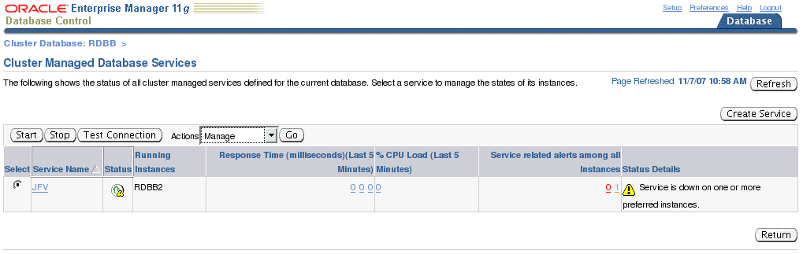
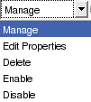
Manage Services with Enterprise Manager
Notes:
Manage Services with Enterprise Manager
You can use Enterprise Manager to manage services within a GUI framework. The screenshot shown in the slide is the main page for administering services within RAC. It shows you some basic status information about a defined service.
To access this page, click the Cluster Managed Database Services link on the Cluster Database Availability page.
You can perform simple service management such as enabling, disabling, starting, stopping, and relocating services. All possible operations are shown in the slide.
If you choose to start a service on the Cluster Managed Database Services page, then EM attempts to start the service on every preferred instance. Stopping the service stops it on all instances that it is currently running.
To relocate a service, choose the service that you want to administer, select the Manage option from the Actions drop-down list, and then click Go.
Note: On the Cluster Managed Database Services page, you can test the connection for a service.

Slide 41
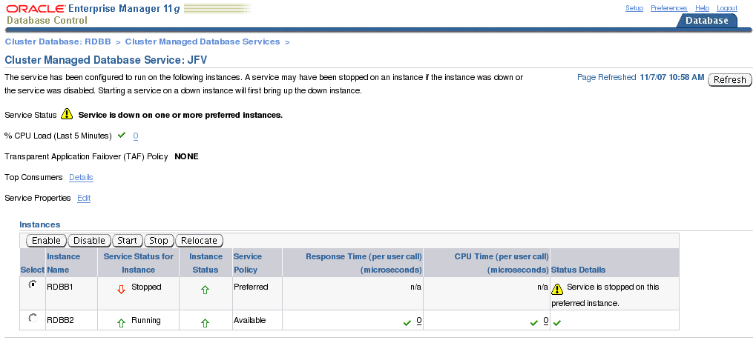
Manage Services with Enterprise Manager
Notes:
Manage Services with Enterprise Manager (continued)
To access the Cluster Managed Database Service page for an individual service, you must choose a service from the Cluster Managed Database Services page, select the Manage option from the Actions drop-down list, and then click Go.
This is the Cluster Managed Database Service page for an individual service. It offers you the same functionality as the previous page, except that actions performed here apply to specific instances of a service.
This page also offers you the added functionality of relocating a service to an available instance. Relocating a service from one instance to another stops the service on the first instance and then starts it on the second.
Note: This page also shows you the TAF policy set for this particular service. You can directly edit the service’s properties, or link to the Top Consumers page.

Slide 42
Manage Services: Example
  Start a named service on all preferred instances:
  Stop a service on selected instances:
  Disable a service at a named instance:
  Set an available instance as a preferred instance:
$ srvctl start service –d PROD –s AP
$ srvctl stop service –d PROD –s AP –i RAC03,RAC04
$ srvctl disable service –d PROD –s AP –i RAC04
$ srvctl modify service –d PROD –s AP -i RAC05 –r
Notes:
Manage Services: Example
The slide demonstrates some management tasks with services by using SRVCTL.
Assume that an AP service has been created with four preferred instances: RAC01, RAC02, RAC03, and RAC04. An available instance, RAC05, has also been defined for AP.
In the first example, the AP service is started on all preferred instances. If any of the preferred or available instances that support AP are not running but are enabled, then they are started.
The stop command stops the AP service on instances RAC03 and RAC04. The instances themselves are not shut down, but remain running possibly supporting other services. The AP service continues to run on RAC01 and RAC02. The intention might have been to perform maintenance on RAC04, and so the AP service was disabled on that instance to prevent automatic restart of the service on that instance. The OCR records the fact that AP is disabled for RAC04. Thus, Oracle Clusterware will not run AP on RAC04 until the service is enabled later.
The last command in the slide changes RAC05 from being an available instance to a preferred one. This is beneficial if the intent is to always have four instances run the service because RAC04 was previously disabled.
Do not perform other service operations while the online service modification is in progress.
Note: For more information, refer to the Oracle Real Application Clusters Administrator’s Guide.

Slide 43
Manage Services: Scenario
DW
HR
DW
HR
I1
I2
I3
I4
I5
I6
I1
I2
I3
I4
I5
I6
Payday
Holiday season
srvctl modify service –d PROD –s DW –n –i I1,I2,I3,I4 –a I5,I6
srvctl modify service –d PROD –s HR –n –i I5,I6 –a I1,I2,I3,I4
srvctl stop service –d PROD –s DW,HR -f
srvctl start service –d PROD –s DW,HR
Notes:
Manage Services: Scenario
The slide presents a possible change in a service configuration with a minimum down time for your workload.
It is assumed that you have a six-node cluster where you run two services: DW and HR. Originally, DW is configured to have I1 and I2 instances as its preferred instances, and I3, I4, I5, and I6 as its available instances. Similarly, HR is originally configured to have I3, I4, I5, and I6 as its preferred instances, and I1 and I2 as its available instances. This initial configuration corresponds to the Payday period (as shown in the left part of the graphic).
During the Holiday season, you need to change your services configuration so that DW is now run on the first four instances, and HR on the remaining two.
From the top going down, the slide shows you the commands you need to execute to switch your services configuration.
Note that the –n option of the srvctl modify service commands is used to remove the initial configuration of your services. The changes take effect when the services are next restarted. You can also use the –f option for these commands so that the next stop command disconnects corresponding sessions. Here, you prefer using the –f option with the srvctl stop service commands, which stop the services globally on your cluster.
You then use the srvctl start service commands to use the newly created service configuration.

Slide 44

Using Distributed Transactions with RAC
  Scope of application: XA or MS DTC
  Fully supported by default on RAC (GTXn background)
  Or all transaction branches occur on same instance:
dbms_service.modify_service(service_name=>'S1', DTP=>TRUE)
dbms_service.modify_service(service_name=>'S2', DTP=>TRUE)
Mid-tier
partition 1
S1
S0
S1
S2
RAC01
Mid-tier
non-DT
S0
S0
S1
S2
RAC02
Mid-tier
partition 2
S2
S0
S1
S2
RAC03
Notes:
Using Distributed Transactions with RAC
When you use RAC with distributed transactions (compliant with XA standard or coordinated by Microsoft Distributed Transaction Coordinator), it is possible for two application components in the same transaction to connect to different nodes of a RAC cluster. This situation can occur on systems with automatic load balancing where the application cannot control which database nodes a distributed transaction branch gets processed.
Starting with Oracle RAC 11gR1, these types of distributed transactions are automatically controlled by the system through the use of new background processes called GTX0…GTXj. GLOBAL_TXN_PROCESSES specifies the initial number of GTXn background processes on an instance, and its default value is 1. Letting the database handle distributed transactions automatically is useful for systems that process global transactions heavily.
To provide improved application performance with distributed transaction processing in Oracle RAC, you may want to take advantage of the specialized service referred to as a DTP service. Using DTP services, you can direct all branches of a distributed transaction to a single instance in the cluster. For load balancing across the cluster, it is better to have several groups of smaller application servers with each group directing its transactions to a single service (or set of services) than to have one or two larger application servers. The graphic in the slide presents a possible solution. Assume that you have three RAC nodes—RAC01, RAC02, and RAC03—with each node capable of servicing any nondistributed transaction coming from a middle tier.

Slide 45
Notes only page
Notes:
Using Distributed Transactions with RAC (continued)
For distributed transactions from other middle tiers, they are partitioned statically via Oracle Net Services to one of these three nodes. Thus, each node publishes itself as an S0 service for nondistributed transactions. In addition, RAC01 and RAC03 publish themselves as a DTP service: S1 and S2, respectively.
As shown in the slide, a DTP service is one that has its DTP flag set to TRUE. In addition, you should always define a DTP service as a singleton service (that is, with only one preferred instance).
Each mid-tier client has Oracle Net Service Names configuration and accesses the Oracle database through Oracle Net. Each Oracle Net Service that is being used for distributed transactions is configured with one DTP service.
The Oracle server ensures the cardinality of a DTP service to be 1 across the RAC cluster, prohibiting more than one instance of the same DTP service from running in a RAC database. Each distributed transaction is processed by one of the DTP services via Oracle Net, so that all tightly coupled branches of the distributed transaction are routed to the same node of the RAC database. Different distributed transactions can be load balanced to different RAC nodes via different DTP services. If one of these database nodes fails, Oracle Clusterware and RAC automatically detect the failure and do the transaction recovery before starting the corresponding DTP service on one of the available RAC nodes. When the node comes back, the same DTP service may be relocated back automatically depending on the workload.

Slide 46

Restricted Session and Services
ALTER SYSTEM
ENABLE RESTRICTED SESSION;
1
2
RAC01
RAC02
ERP
ERP
ERP
ERP
Oracle
Clusterware
4
ERP
3
ERP
5
Notes:
Restricted Session and Services
Whenever you put one instance of the cluster in restricted mode, Oracle Clusterware stops the services running on the restricted instance, and it starts them on available instances if they exist. That way, the listeners are dynamically informed of the changes, and they no longer attempt to route requests to the restricted instance, regardless of its current load. In effect, the listeners exempt the restricted instance from their connection load-balancing algorithm.
This feature comes with two important considerations:
First, even users with RESTRICTED SESSION privilege are not able to connect remotely through the listeners to an instance that is in the restricted mode. They need to connect locally to the node supporting the instance and use the bequeath protocol.
Second, this new feature works only when the restricted instance dynamically registers with the listeners. That is, if you configure the listener.ora file with SID_LIST entries, and you do not use dynamic registration, the listener cannot block connection attempts to a restricted instance. In this case, and because the unrestricted instances of the cluster are still accessible, the restricted instance will eventually become least loaded, and the listener will start routing connection requests to that instance. Unable to accept the connection request because of its restricted status, the instance will deny the connection and return an error. This situation has the potential for blocking access to an entire service.
Note: The listener uses dynamic service registration information before static configurations.

Slide 47
Summary
In this lesson, you should have learned how to:
  Configure and manage services in a RAC environment
  Use services with client applications
  Use services with the Database Resource Manager
  Use services with the Scheduler
  Set performance-metric thresholds on services
  Configure services aggregation and tracing
Notes:
Oracle Database 11g: RAC Administration 7 - <number>

Slide 48
Practice 7: Overview
This practice covers the following topics:
  Defining services by using DBCA
  Managing services by using Enterprise Manager
  Using server-generated alerts in combination with services
Notes:
Oracle Database 11g: RAC Administration 7 - <number>

